Slide 1
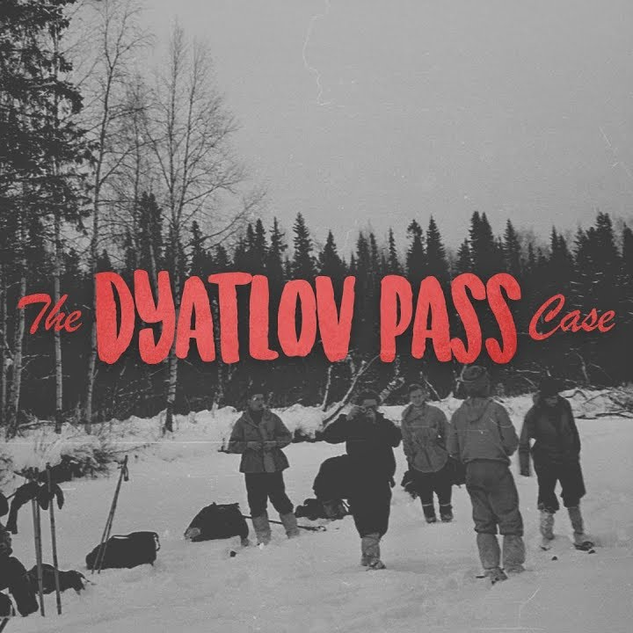
The Dyatlov incident,
A mystery unexplained to man till this day.

Slide 2
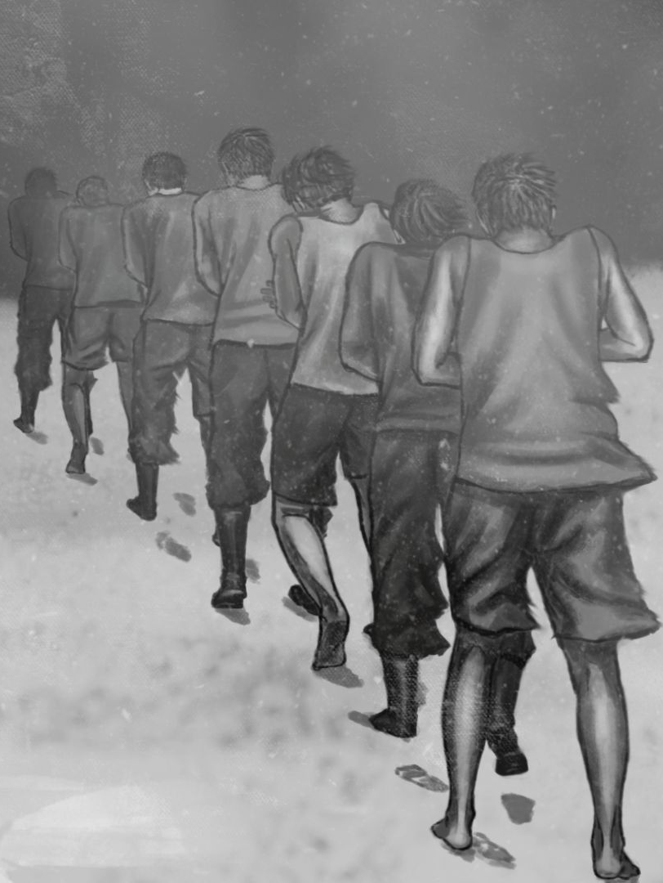
How Everything Started
On an early morning on the January of 23rd, 1959 a team of ten hikers boarded a train and headed for Ural mountains in
Sverdlovsk Oblast, Soviet Union.
The group consisted of 8 men and 2 women, with Igor Dyatlov as the group’s leader.
After several days of hiking and trekking, one of the men fell ill, and decided to go back while he could. So he said his goodbyes to his dearest friends and departed.
Little did he knew, this was the last time he would see his friends.

Slide 3
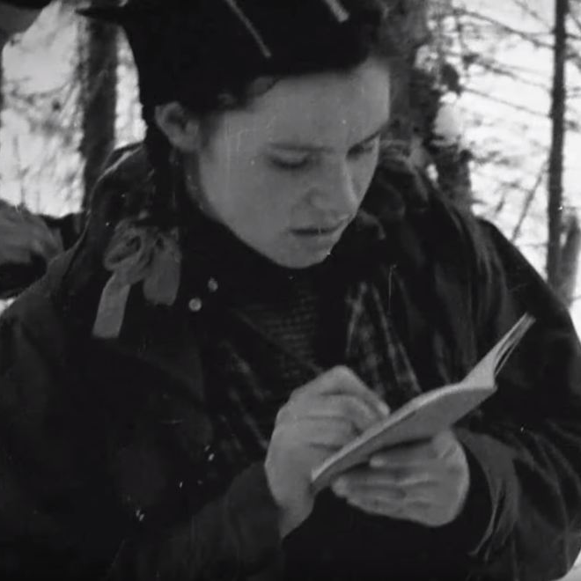
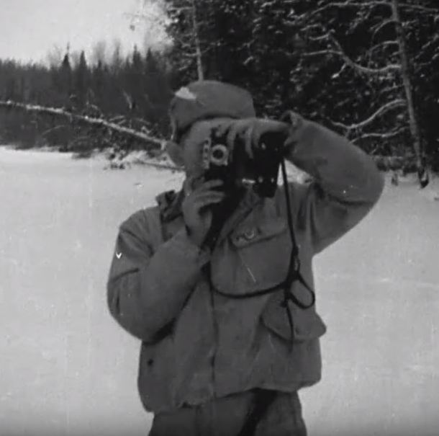
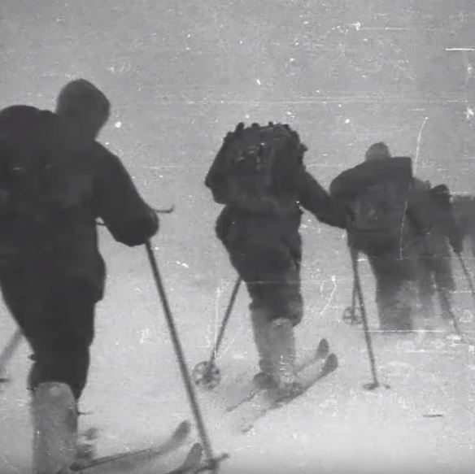
How Everything Started
The group ventured on with their expedition across the snow covered Mountains, and documented everything of significance. Their documents upon checking show that their trek proceeded with no unforeseen complications.
On February 1st, they reached the peak of what was known as the Dead Mountain. Following are the last photos recovered and the final entry
“It is difficult to imagine such a comfort on the ridge, with shrill howling wind, hundreds of kilometers away from human settlements.”

Slide 4
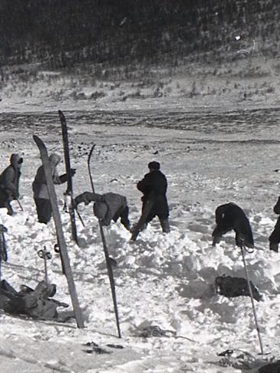
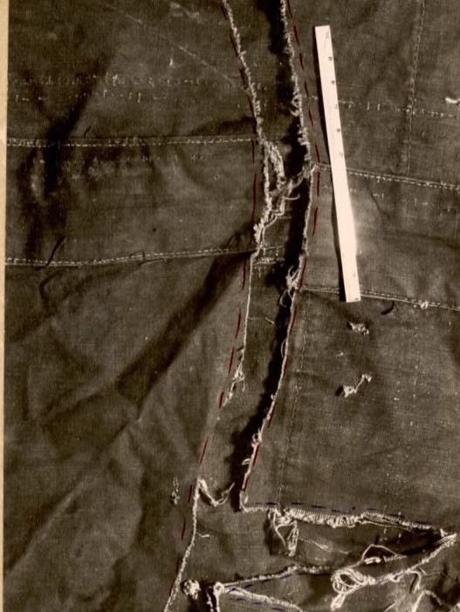
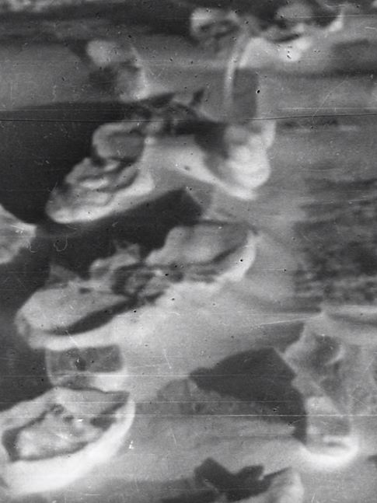
The Search
After a good chunk of time passing by, their friends and families started worrying, and on the 26th February, a search party located the camp on the slope. A tent was found, but upon further inquiry it came to light that the tent had been slashed open from the inside with a knife.
The search volunteers followed nine pairs of footprints down the slope, towards the nearby woods

Slide 5
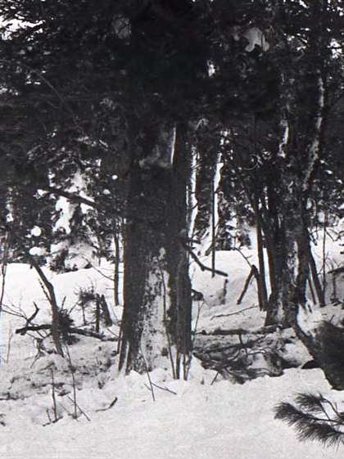
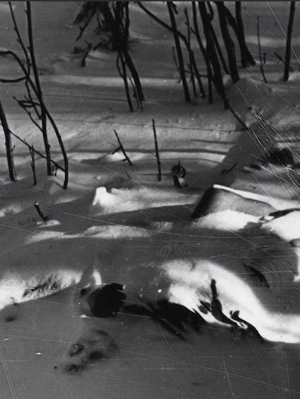
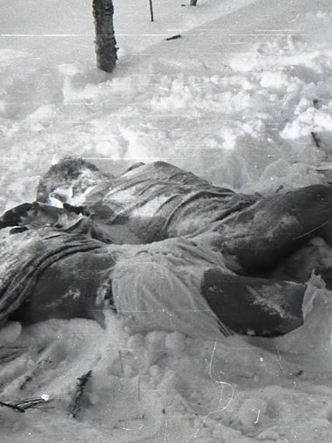
The Search
just vibing doe
Following the trail for about half a kilometer, the search party found the remains of an improvised campfire, and next to the remains, they found dead bodies of two of the trekkers. Namely, Yuri Doroshenko and Yuri Krivonoschenko.

Slide 6
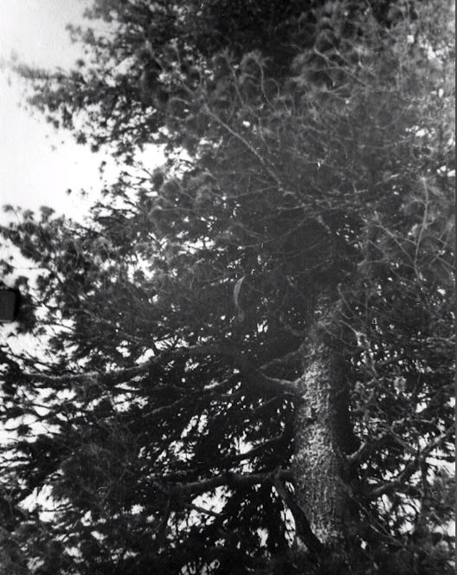
The Bodies
It would take over two months to find the bodies of all the hikers, but the first two bodies found were severely underdressed, no accessories like jackets, keys, sweaters etc. were found.
The cedar tree was damaged with its broken
branches, as if someone had attempted to
hide from someone or something.
The next 3 bodies were found at varying
distances, but they still lacked essential
items such as boots, hats and gloves.
Upon further inquiry, it was discovered that
while all of them suffered from minor
injuries, the cause of death for all five was
Hypothermia. The last four hikers were
found at the bottom of the hill, 75 meters from
the tree. Three of them had lethal injuries,
fractured skulls, massive internal bleeding
and broken ribs.

Slide 7

Hi, just a real quick disclaimer,
The images and the content gets
very graphic from here on out, stay
healthy and wholesome kings.

Slide 8
The Bodies
Experts were called and they confirmed that the injuries suffered by the hikers couldn’t have been inflicted from another person, and that they must have been alive when they got them.
Two of them had been found with gaping eye sockets, and a women with a missing tongue. The last of the four had a broken nose and a deformed neck but cause of death was hypothermia.
The most mysterious part was that their articles of clothing were later found to be abnormally radioactive.
The case was closed on May 28th with a cryptic and vague conclusion:
“The cause of death was an unknown and compelling force which the hikers were unable to overcome.”

